Slide 1


All about me ☺
Becca thomson

Slide 2

My family ☺
My family is so wonderful. I love them all so much!!!
They are always there for me.
I love them all so much!!!!

Slide 3
Hobbies
The hobbies I do most are…
Sports
Cooking
Computer
Texting
Movies
pets
There are a lot more I could mention!!!

Slide 4

Friends
I have so many wonderful friends. They are always there for me when I need them. They are there through thick and thin.

Slide 5
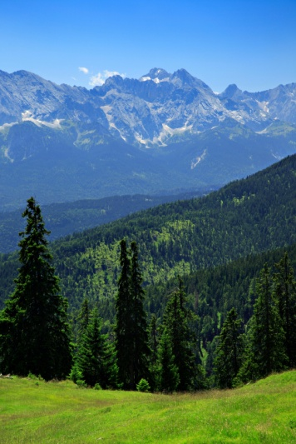
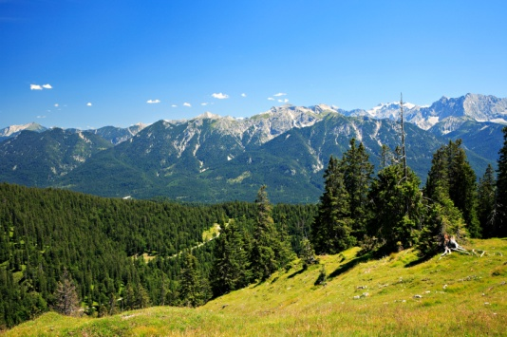
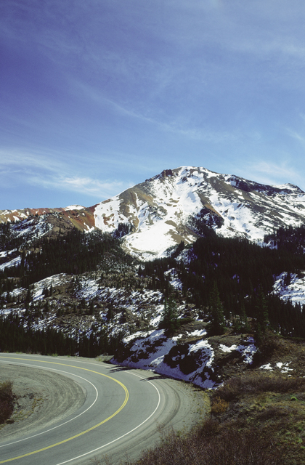
vacations
I have went to many places. Some of them are…
Denver Colorado
Florida
Nebraska
North Carolina
South Carolina
Georgia
Virginia
West Virginia

Slide 6
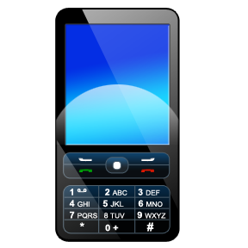

Favorite things
Facebook
My family
Beaches
Sports
Cell phones
Wii

Slide 7
Facts about me
B

